Slide 1


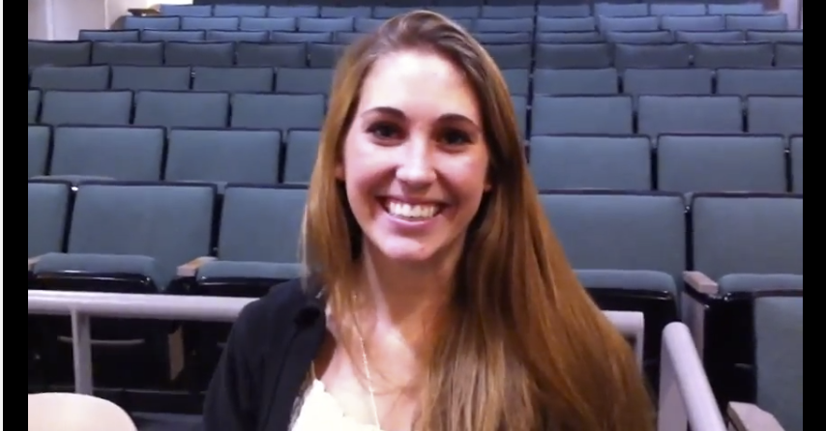
BJC: you’ll love it!
The Beauty and Joy of Computing Lecture #1 Welcome Abstraction
UC Berkeley Teaching Professor Dan Garcia
Watch the student testimonials about the course, what it means to them, and how it has changed their lives. Inspiring!
cs10.org

Slide 2
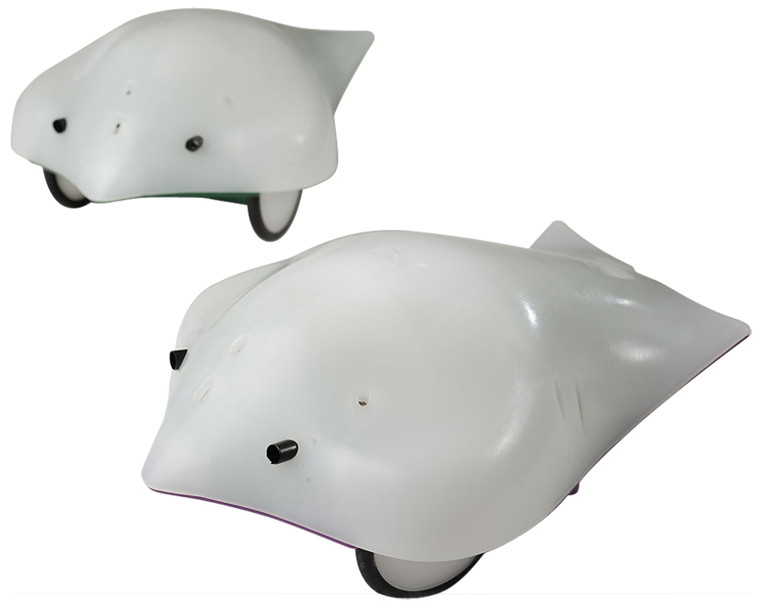
BJC in one slide
Big Ideas of Programming
Abstraction
Algorithms
Recursion
Functions-as-data
Programming Paradigms
Concurrency
Distributed Computing
Beauty and Joy
“CS Unplugged” activities
All lab work in pairs
Two 3-week projects in pairs
Of your own choice!!
One “paper”
Of your’ own choice!!
Big Ideas of Computing
HowStuffWorks
Computers (binary numbers)
Internet
Research Summaries
AI
HCI
Social Implications of Computing
Saving the World with Computing
Power of Big Data
Limits of Computing
Future of Computing
Robots
Set you up for follow-up 61A
We also teach Python!

Slide 3

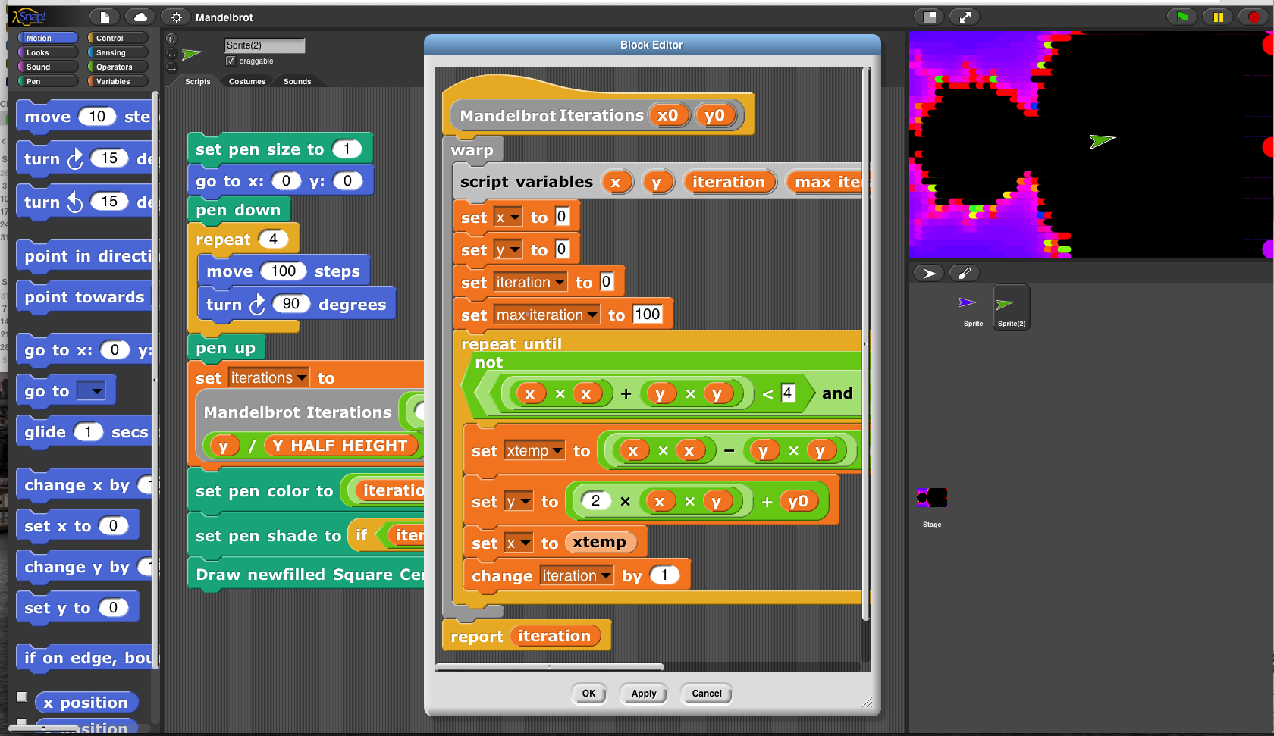
Incredibly easy-to-learn coding in

Slide 4

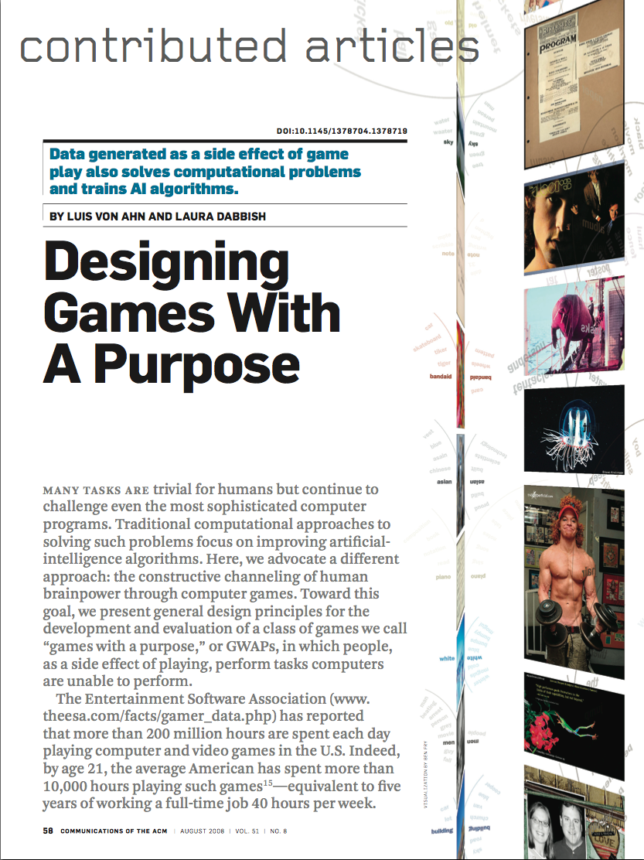
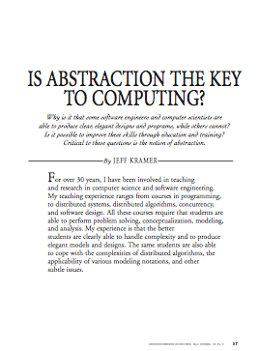
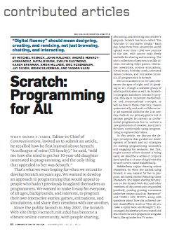
Format & Textbooks
Format (7 hrs/wk * 14 wks) + ~5 hrs of proj/hw/reading
Selected Reading
Taken from great book (“Blown to Bits” by Abelson, Ledeen & Lewis) + articles + videos
Current events EVERY LECTURE (e.g., IBM’s Watson vs Jeopardy)
All resources FREE
Even clickers!
Pair Programming!
Mon | Tue | Wed | Thu | Fri
Lecture | Lab | Lecture | Lab | Discussion
 | Lab |  | Lab
…

Slide 5
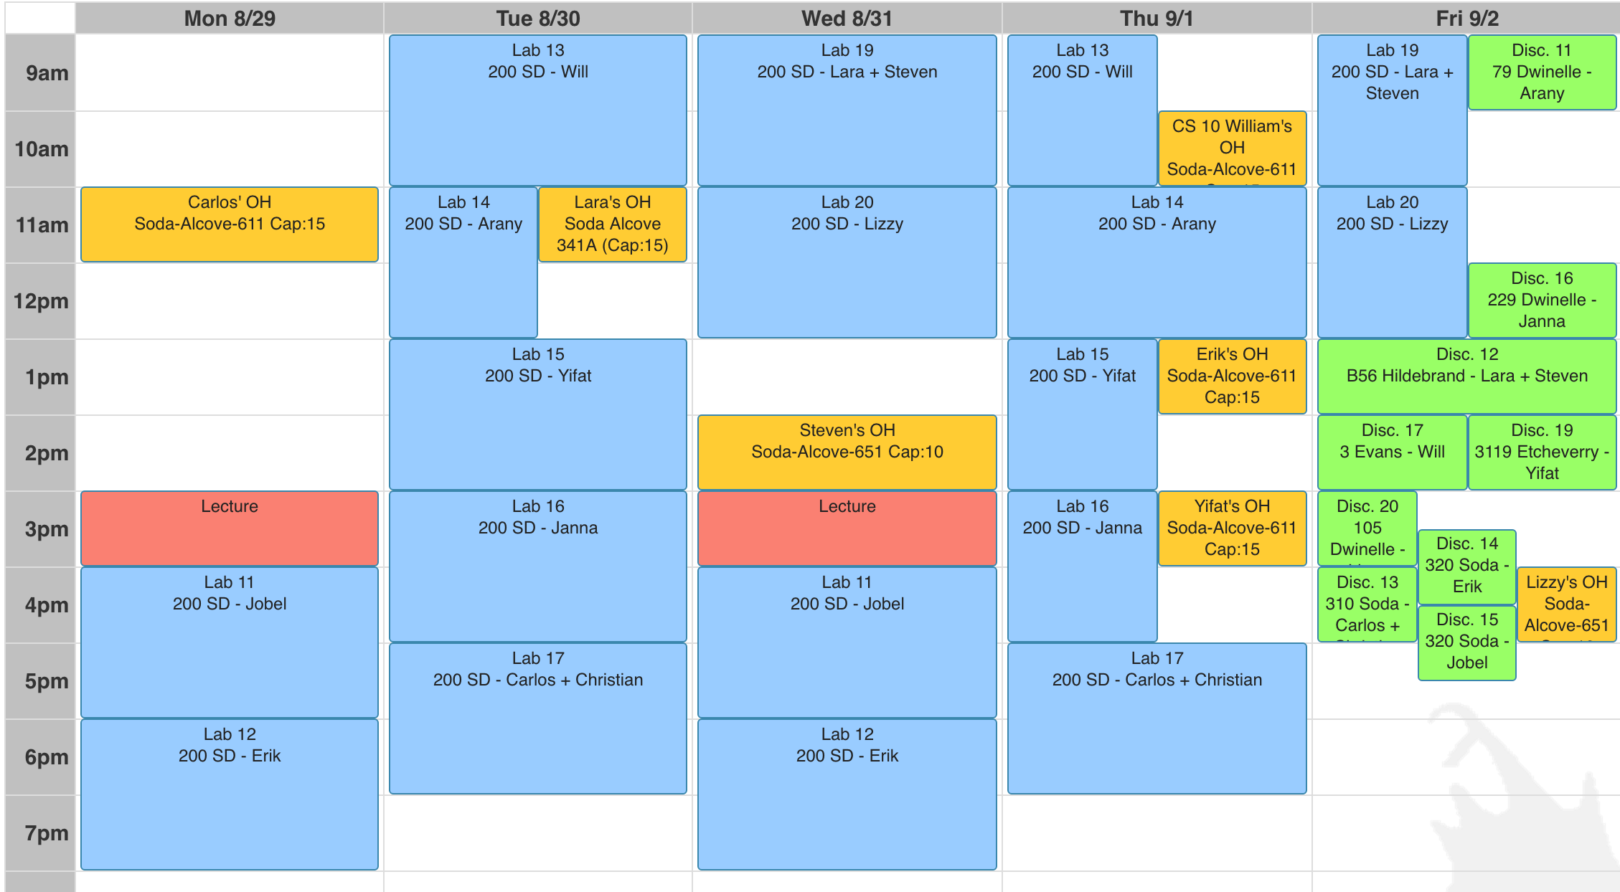
Week at a glance (on cs10.org)

Slide 6
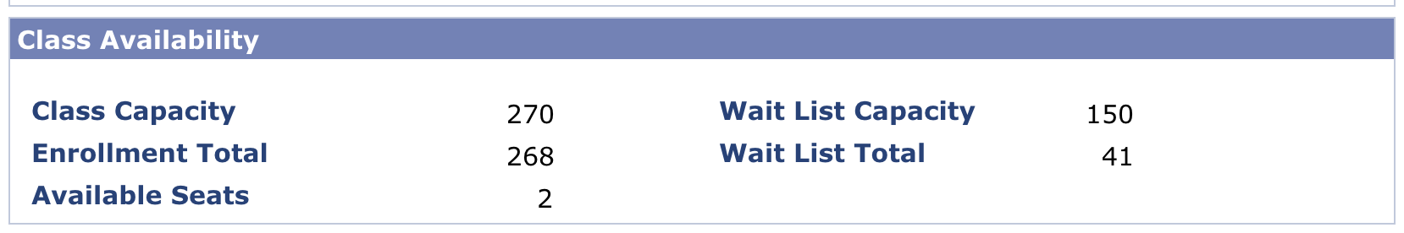
Let’s check enrollments…
We have NEVER turned anyone away, and we don’t intend to turn anyone away this semester!

Slide 7
Other Introductory Courses
Foundations of Data Science, Data Science 8 (CS C8 in the catalog)
Foundations of data science from three perspectives: inferential thinking, computational thinking, and real-world relevance. Given data arising from some real-world phenomenon, how does one analyze that data so as to understand that phenomenon? It teaches critical concepts and skills in computer programming and statistical inference, in conjunction with hands-on analysis of real-world datasets, including economic data, document collections, geographical data and social networks. It delves into social and legal issues surrounding data analysis, including issues of privacy and data ownership. (You learn how to use Python as a tool, not how to program)
Structure and Interpretation of Computer Programs, CS 61A
Introduction to programming and computer science. This course exposes students to techniques of abstraction at several levels: (a) within a programming language, using higher-order functions, manifest types, data-directed programming, and message-passing; (b) between programming languages, using functional and rule-based languages as examples. It also relates these techniques to the practical problems of implementation of languages and algorithms on a von Neumann machine. There are several significant programming projects. (You learn how to program Python well!)

Slide 8
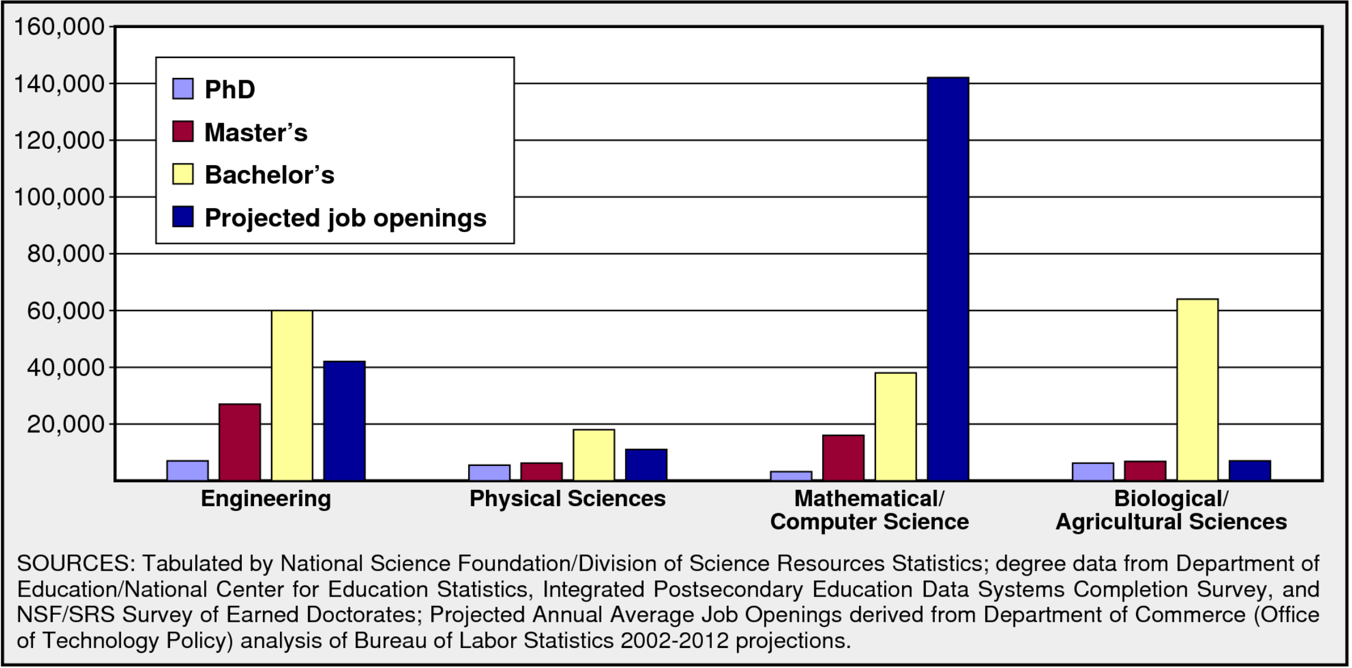

How does a 6-figure/year job sound?
Annual degrees and jobs in broad engineering fields

Slide 9

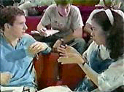
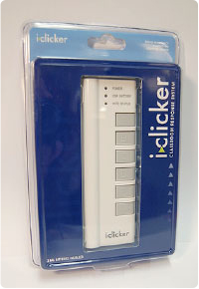
Peer Instruction
Increase real-time learning in lecture, test understanding of concepts vs. details
After a few slides pass, ask multiple choice question
1-2 minutes to decide yourself
2 minutes in pairs/triples to reach consensus. Teach others!
2 minute discussion of answers, questions, clarifications

Slide 10
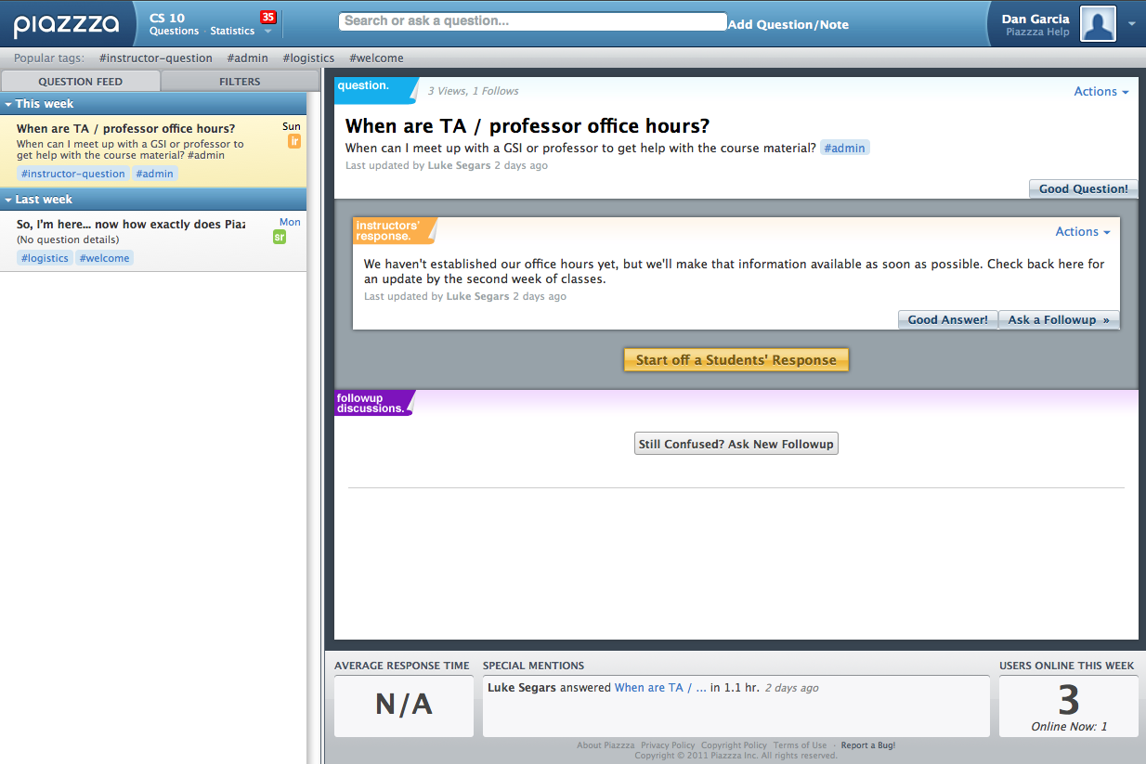
Piazza for {ask,answer}ing questions

Slide 11
Pro-student Grading Policies
EPA
Rewards good behavior
Effort
E.g., Office hours, doing every single lab, hw, reading Piazza pages
Participation
E.g., Raising hand in lec or discussion, asking questions on Piazza
Altruism
E.g., helping other students in lab, answering questions on Piazza
You have 3 “Slip Days”
You use them to extend due date, 1 slip day for 1 day extension
You can use them one at a time or all at once or in any combination
They follow you around when you pair up (you are counted individually)
E.g., A has 2, B has 0. Project is late by 1 day. A uses 1, B is 1 day late
Late is 1/3 off/day

Slide 12
What you will be able to do!
Battleship game
https://www.youtube.com/watch?v=L8QbIaWD6o8
Sudoku
https://www.youtube.com/watch?v=_yAzgt4AGbY
WatercolorBot
https://www.youtube.com/watch?v=-CNTN92pt1o
IMMBY
https://www.youtube.com/watch?v=tzf2Eey57Pw
Kinect
http://www.youtube.com/watch?v=hF5DsX1XGBE

Slide 13

Abstraction
Detail removal
“The act or process of leaving out of consideration one or more properties of a complex object so as to attend to others.”
Generalization
“The process of formulating general concepts by abstracting common properties of instances”
Henri Matisse “Naked Blue IV”

Slide 14
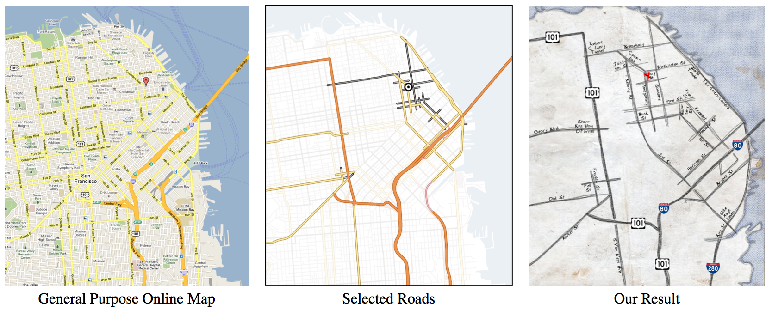
Detail Removal
Automatic Generation of Detail Maps Prof. Maneesh Agrawala, among others

Slide 15
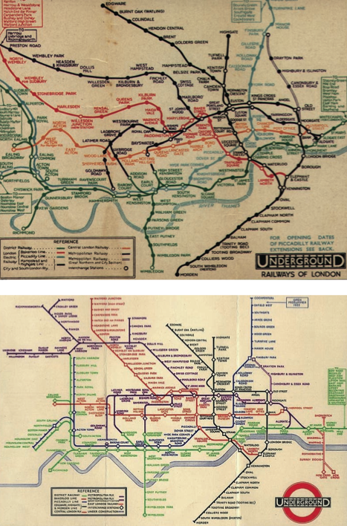
Detail Removal (in BJC)
You’ll want to write a project to simulate a real-world situation, or play a game, or …
Abstraction is the idea that you focus on the essence, the cleanest way to map the messy real world to one you can build
Experts are often brought in to know what to remove and what to keep!
The London Underground 1928 Map & the 1933 map by Harry Beck.

Slide 16
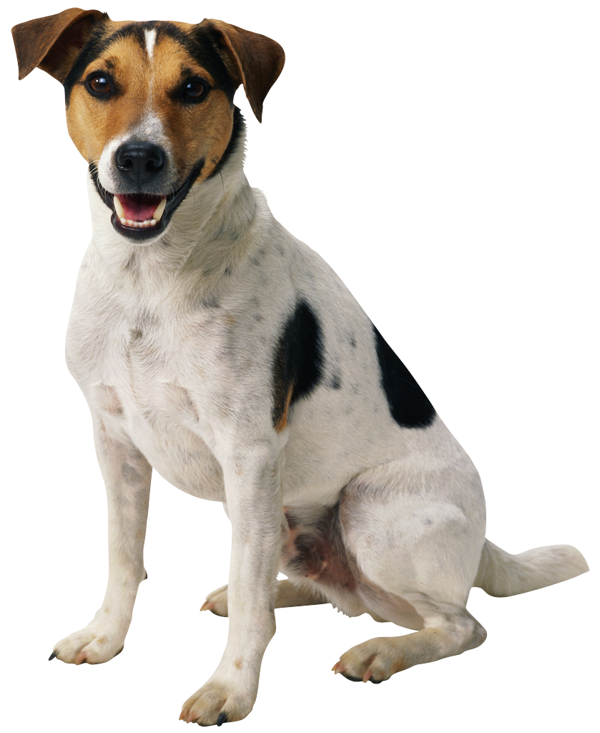
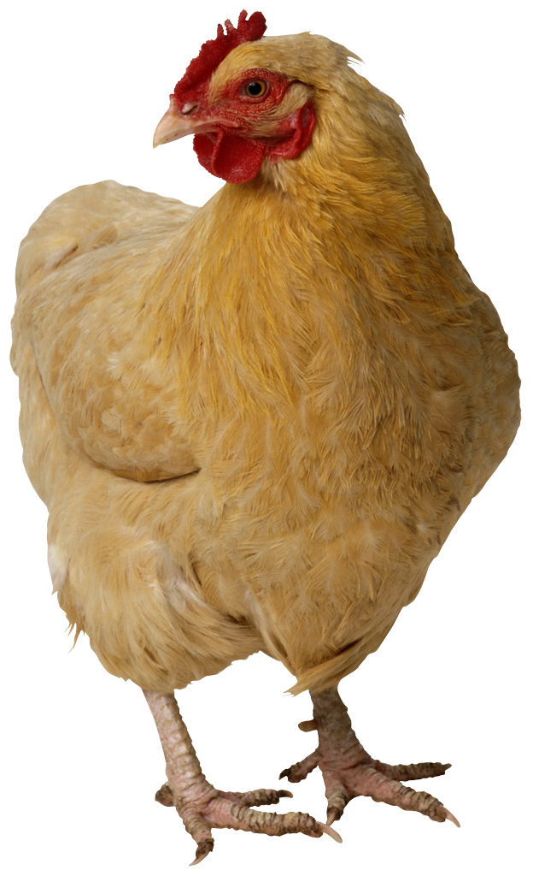

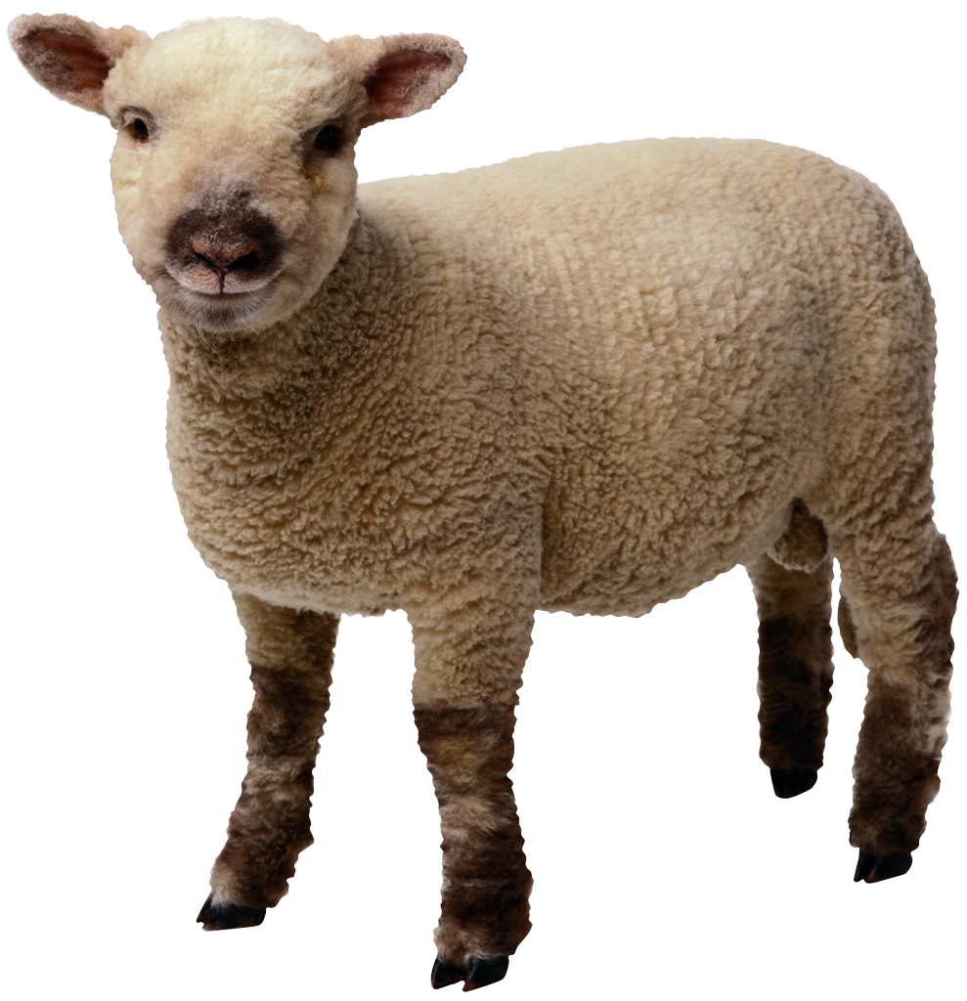
Generalization Example
You have a farm with many animal kinds.
Different food for each
You have directions that say
To feed dog, put dog food in dog dish
To feed chicken, put chicken food in chicken dish
To feed rabbit, put rabbit food in rabbit dish
Etc…
How could you do better?
To feed <animal>, put <animal> food in <animal> dish

Slide 17
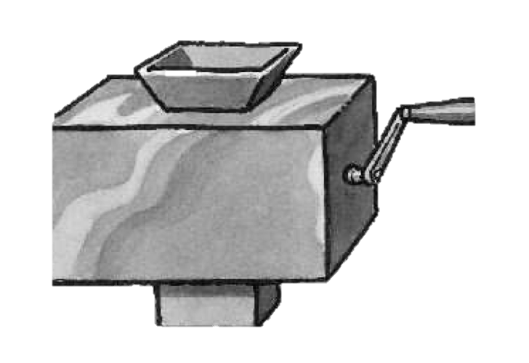
Generalization (in BJC)
You are going to learn to write functions, like in math class:
y = sin(x)
You should think about what inputs make sense to use so you don’t have to duplicate code
“Function machine” from Simply Scheme (Harvey)

Slide 18
The Power of Abstraction, everywhere!
Examples:
Functions (e.g., sin x)
Hiring contractors
Application Programming Interfaces (APIs)
Technology (e.g., cars)
Amazing things are built when these layer
And the abstraction layers are getting deeper by the day!
We only need to worry about the interface, or specification, or contract
NOT how (or by whom) it’s built
Above the abstraction line
Abstraction Barrier (Interface) (the interface, or specification, or contract)
Below the abstraction line
This is where / how / when / by whom it is actually built, which is done according to the interface, specification, or contract.

Slide 19
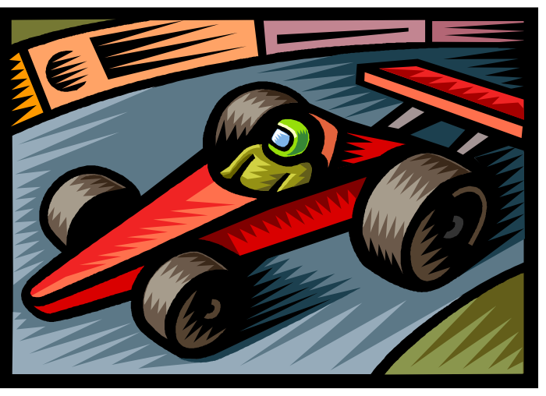
Summary
Abstraction is one of the big ideas of computing and computational thinking
Think about driving. How many of you know how a car works? How many can drive a car? Abstraction!
Someone who drove in 1930 could still drive a car today because they’ve kept the same Abstraction!
(right pedal faster, left pedal slow)
…they probably would have trouble starting a new one though, or shifting an electric car from “park” into “drive”

